Slide 1

Deep Learning
Lecture 7: Convolutional Neural Networks
Stan Z. Li

Slide 2
Outline
Multilayer Perceptrons
Training and Optimization
Convolution Neural Networks
Classic CNN Model Architectures
Notes:
Looking for a Function

Slide 3
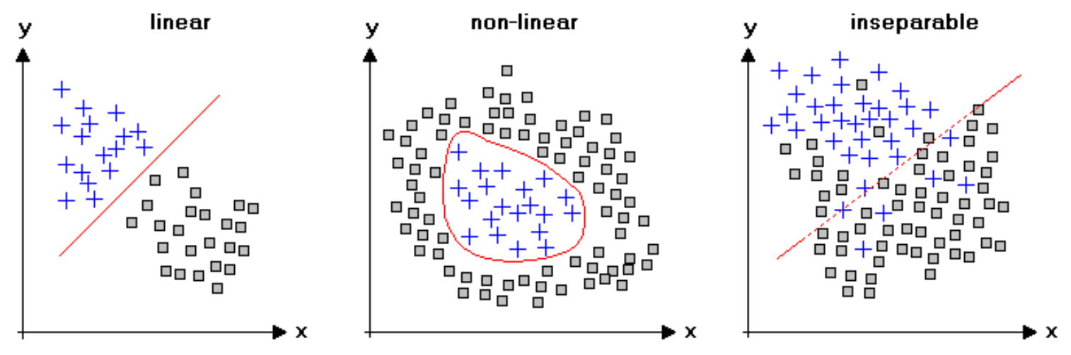
Separability in Classification Problems
Data samples are not always linearly separable, but may be nonlinearly separable.

Slide 4
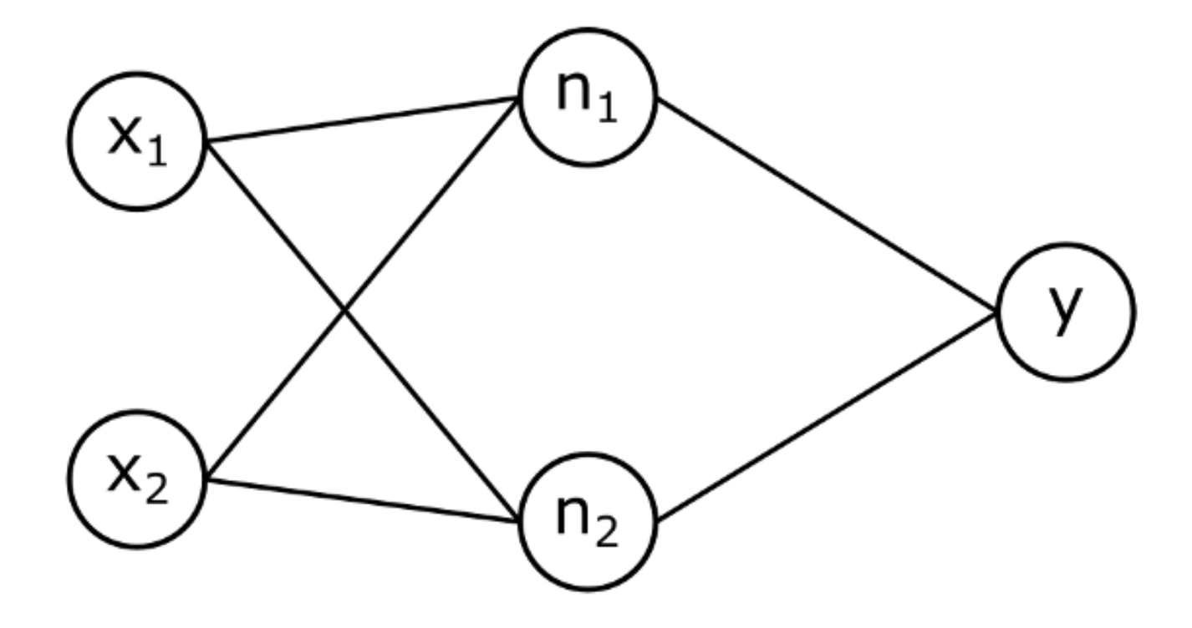
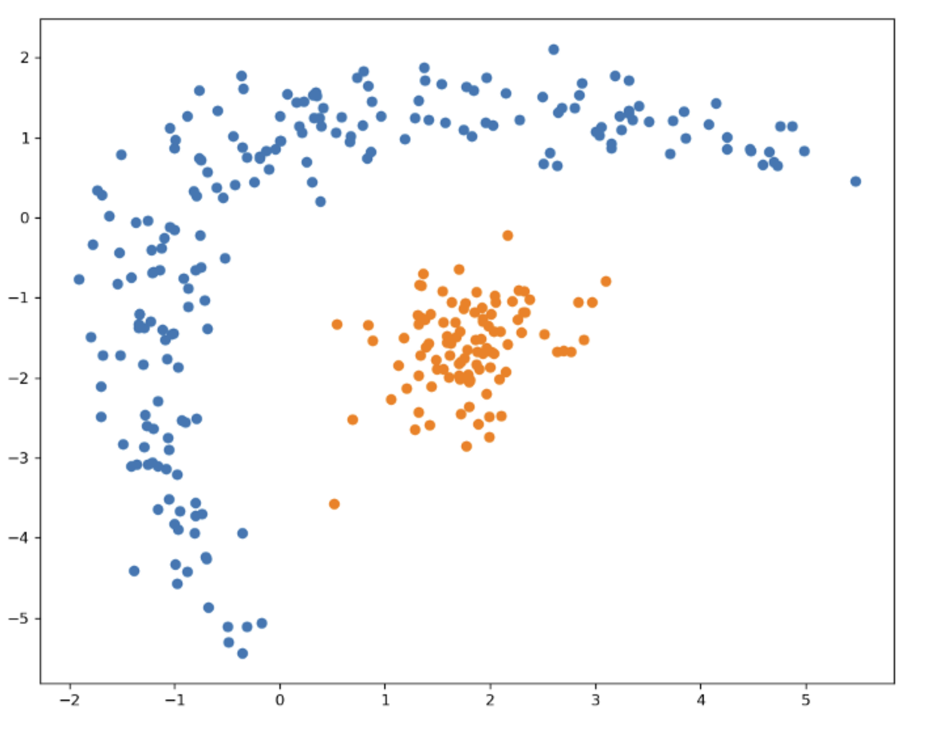
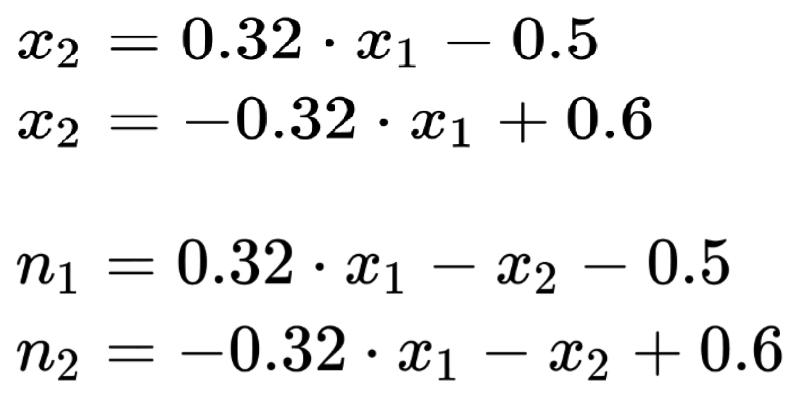
Nonlinearly Separable

Slide 5
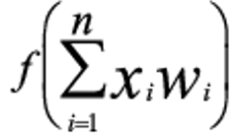
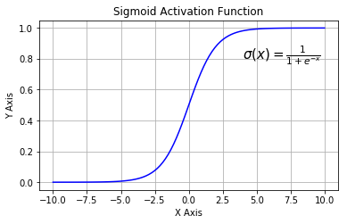
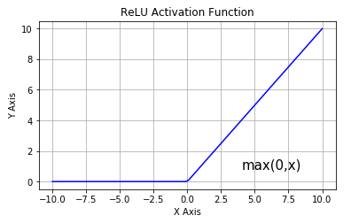
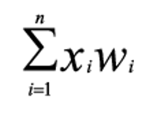
Activation Function
Notes:
Problems with Sigmoid:
梯度消失：注意：Sigmoid 函数趋近 0 和 1 的时候变化率会变得平坦，也就是说，Sigmoid 的梯度趋近于 0。神经网络使用 Sigmoid 激活函数进行反向传播时，输出接近 0 或 1 的神经元其梯度趋近于 0。这些神经元叫作饱和神经元。因此，这些神经元的权重不会更新。此外，与此类神经元相连的神经元的权重也更新得很慢。该问题叫作梯度消失。因此，想象一下，如果一个大型神经网络包含 Sigmoid 神经元，而其中很多个都处于饱和状态，那么该网络无法执行反向传播。
计算成本高昂：exp() 函数与其他非线性激活函数相比，计算成本高昂。

Slide 6
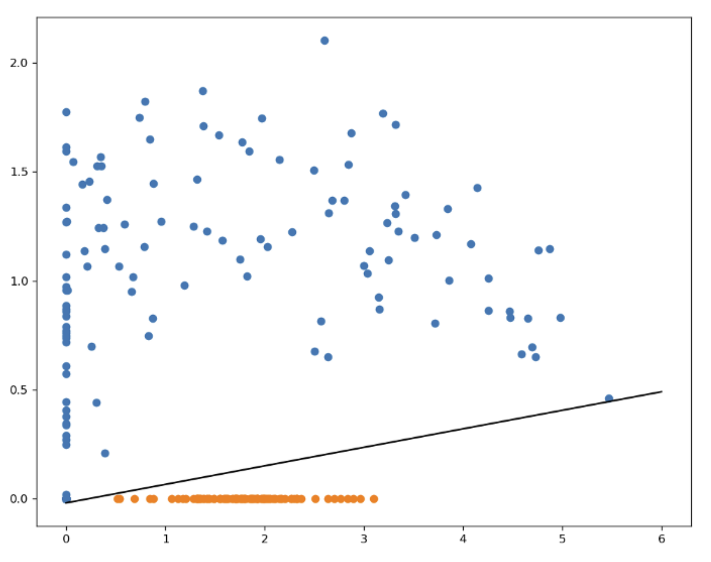
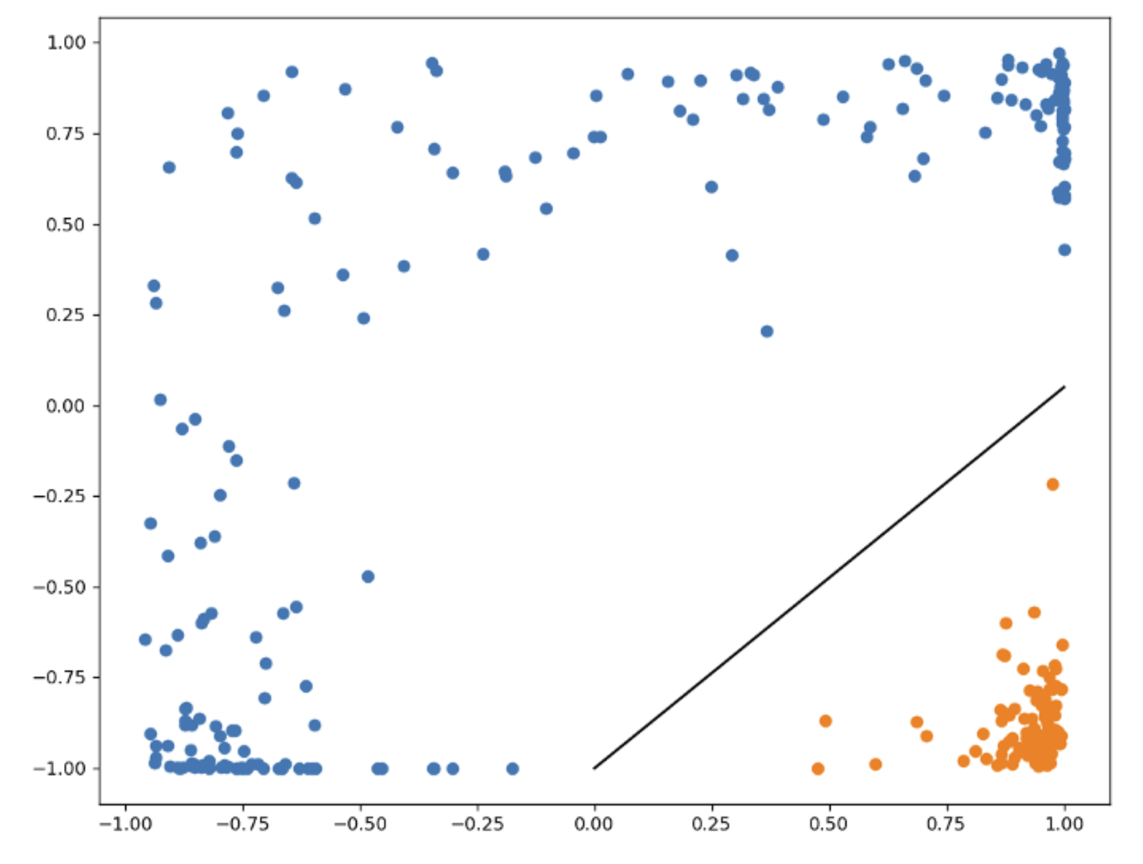
Using Activation Function for Separability
Original
ReLU
Tanh

Slide 7
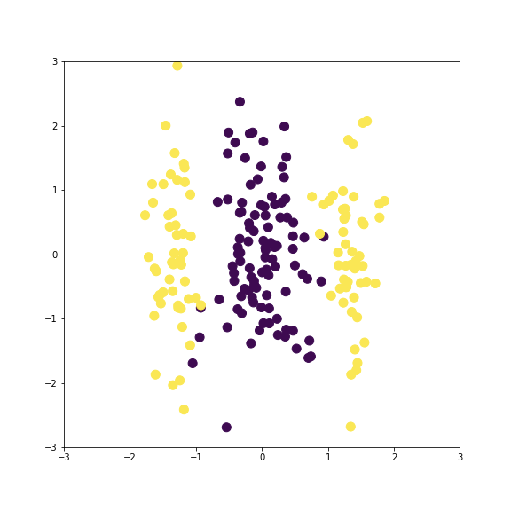
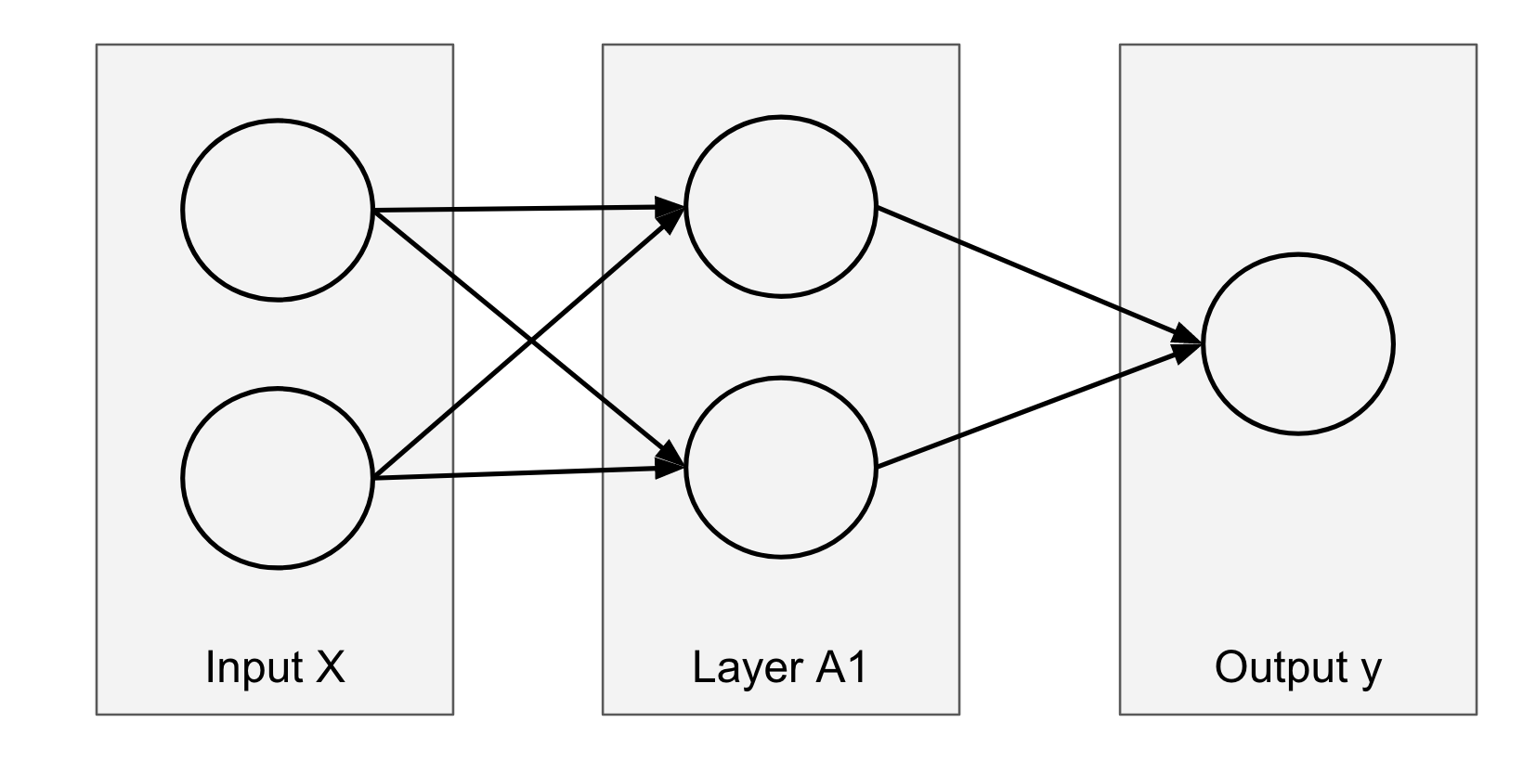
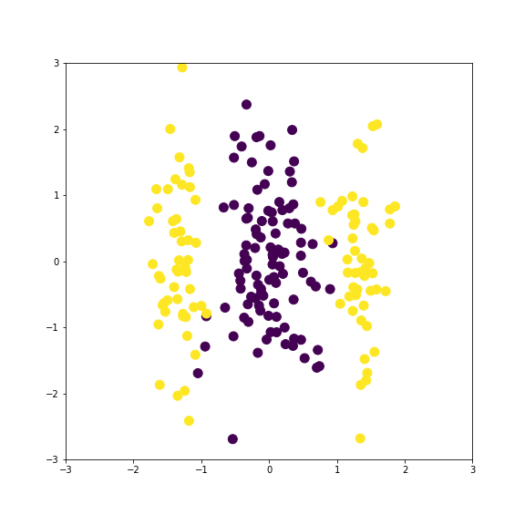
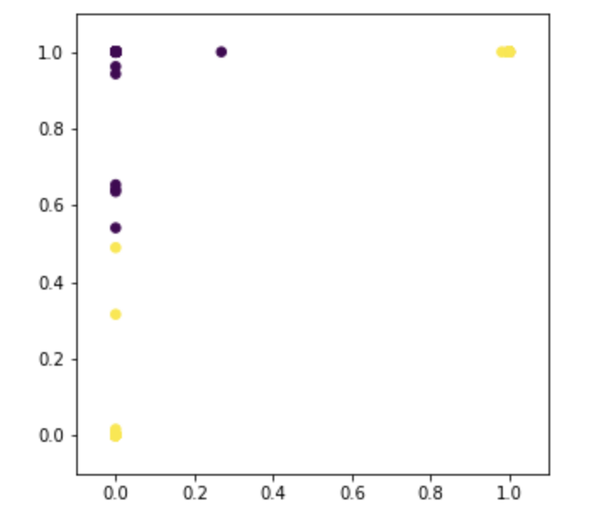
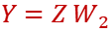
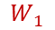
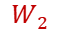
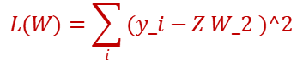
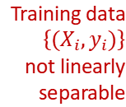
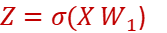
Learning W as Optimization
$$z_{2}$$
$$W_{1}$$
$$W_{2}$$
Training data $\left\{{(X}_{i},y_{i})\right\}$
not linearly separable
$${Y=Z W}_{2}$$
${Z=σ(X W}_{1}$)
$$z_{1}$$
$$L(W)=\sum_{i}{(y_i−Z W_2 )^2}$$
Notes:
https://towardsdatascience.com/animations-of-neural-networks-transforming-data-42005e8fffd9

Slide 8
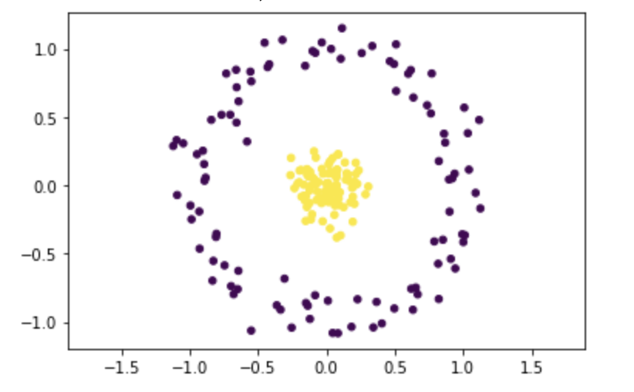
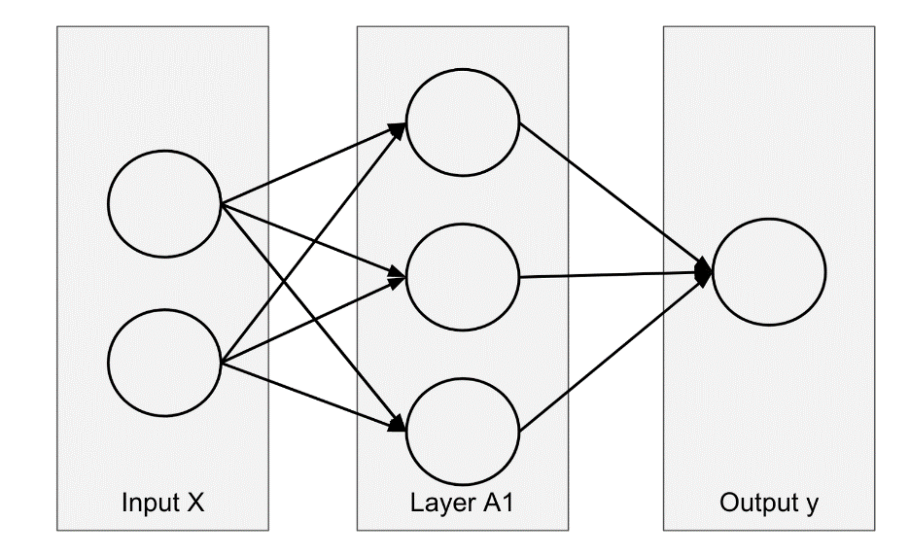
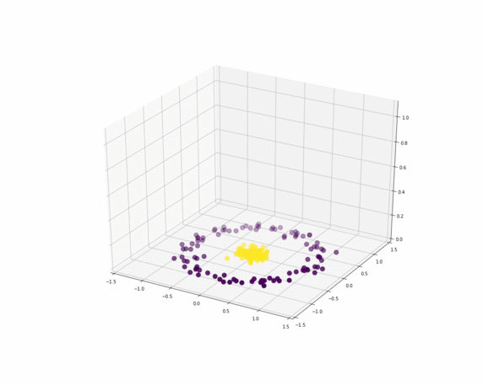
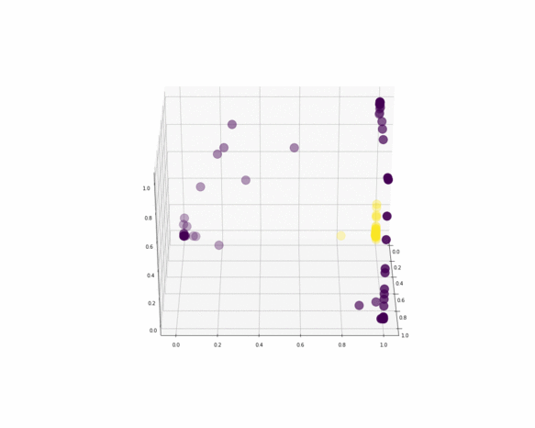
Learning W for Nonlinear Transformation
Notes:
https://towardsdatascience.com/animations-of-neural-networks-transforming-data-42005e8fffd9

Slide 9
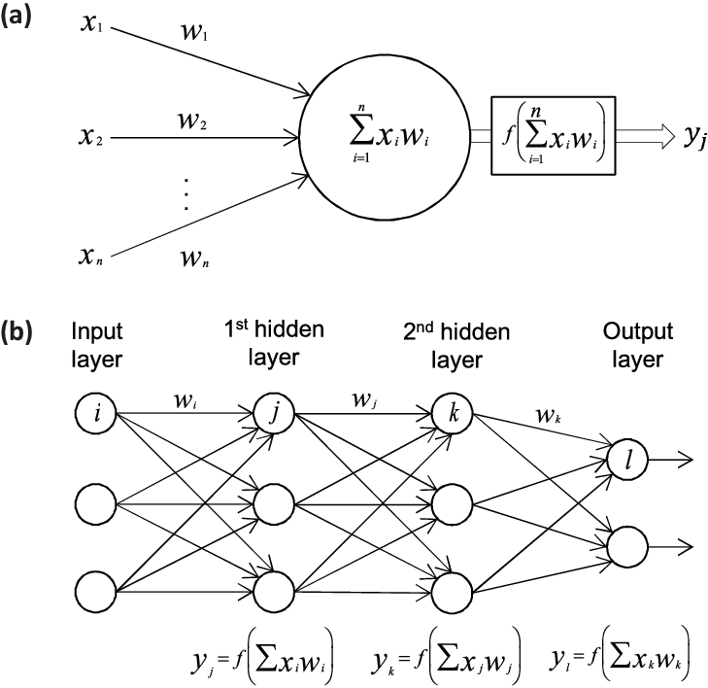
Multilayer Perceptrons
Perceptron：1 Layer
1 Neuron
MLP:
3 Layer 3+3+2 Neurons
Notes:
Now we review the basic structure of MLP, which I believe was covered by Dr. Zhang Yue in the lecture last week.
Each neuron in the network, except those in the input layer, can be thought of as being a linear classifier that takes as input all the outputs of the neurons in the previous layer and computes a weighted sum of those plus a bias term. Then, the neurons in the next layer will take as input the values computed by the previous layer of linear classifiers, then compute a weighted sum of those, and so on. We hope that, by combining linear classifiers in this way, we can construct more complex classifiers that can represent non-linear patterns in our data.

Slide 10
Outline
Multilayer Perceptron
NN Training and Optimization
Convolution Neural Networks
Classic CNN Model Architectures
Notes:
Looking for a Function

Slide 11
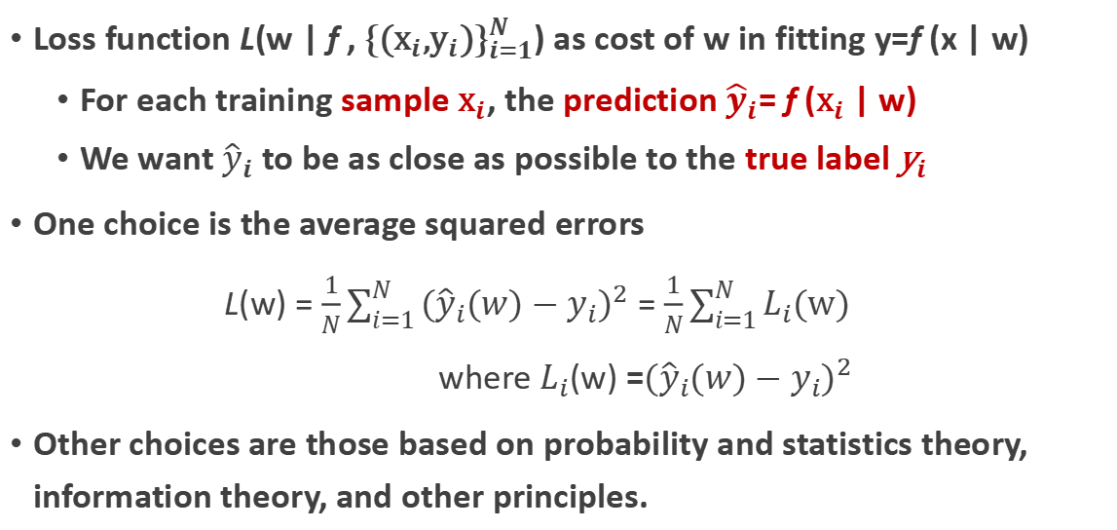
Loss Function
Loss function L(w | f , ${\text{\{(}{\text{x}}_{i}\text{,}{\text{y}}_{i}\text{)\}}}_{i=1}^{N}$) as cost of w in fitting y=f (x | w)
For each training sample ${\text{x}}_{i}$, the prediction ${\hat{y}}_{i}$= f (${\text{x}}_{i}$ | w)
We want ${\hat{y}}_{i}$ to be as close as possible to the true label ${\text{y}}_{i}$
One choice is the average squared errors
L(w) = $\frac{1}{N}\sum_{i=1}^{N}{{({\hat{y}}_{i}(w)−y_{i})}^{2}}$ = $\frac{1}{N}\sum_{i=1}^{N}{L_{i}\text{(}\text{w}\text{)}}$
where $L_{i}$(w) =${({\hat{y}}_{i}(w)−y_{i})}^{2}$
Other choices are those based on probability and statistics theory, information theory, and other principles.
Notes:
The training guides are {xi, yi, hat yi}. hat yi depends on w

Slide 12
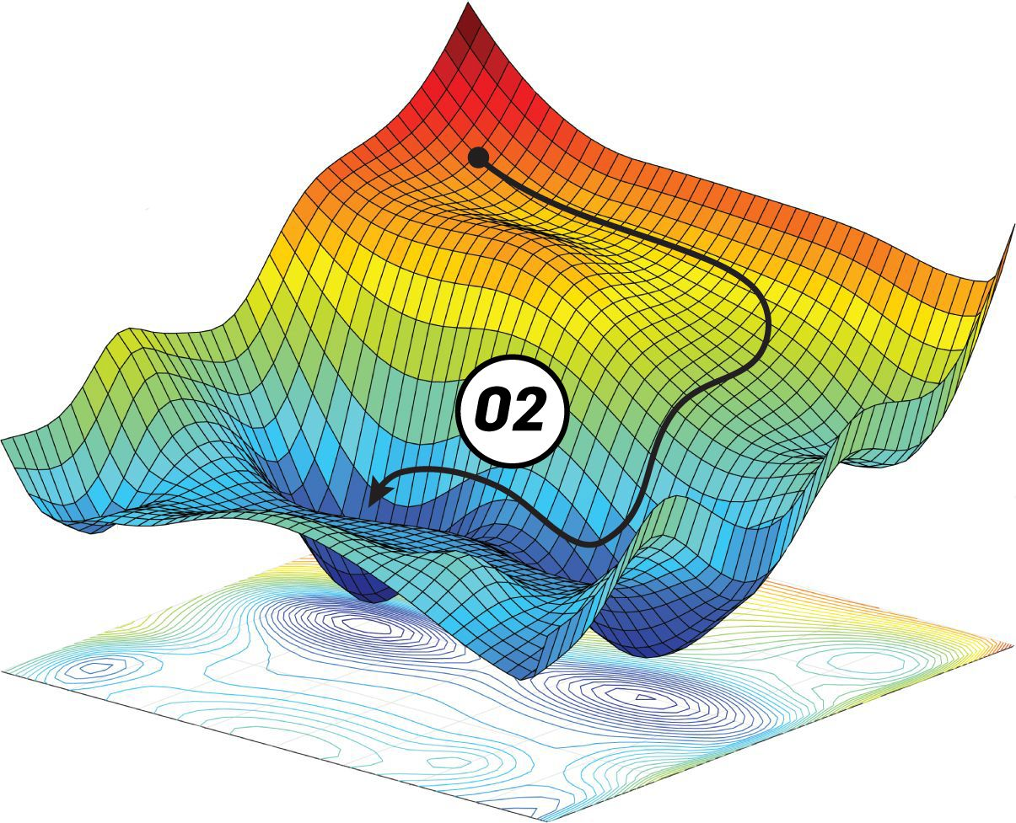
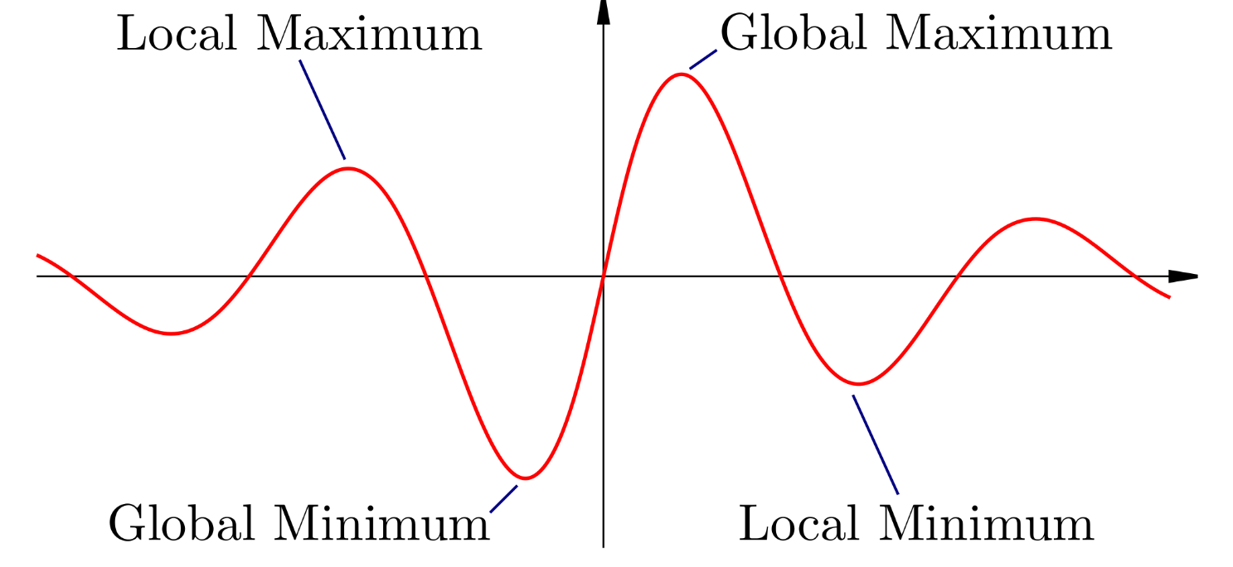
Local vs Global Minima
L(w)
w
Notes:
https://blog.paperspace.com/tag/series-gradient-descent-with-python/

Slide 13
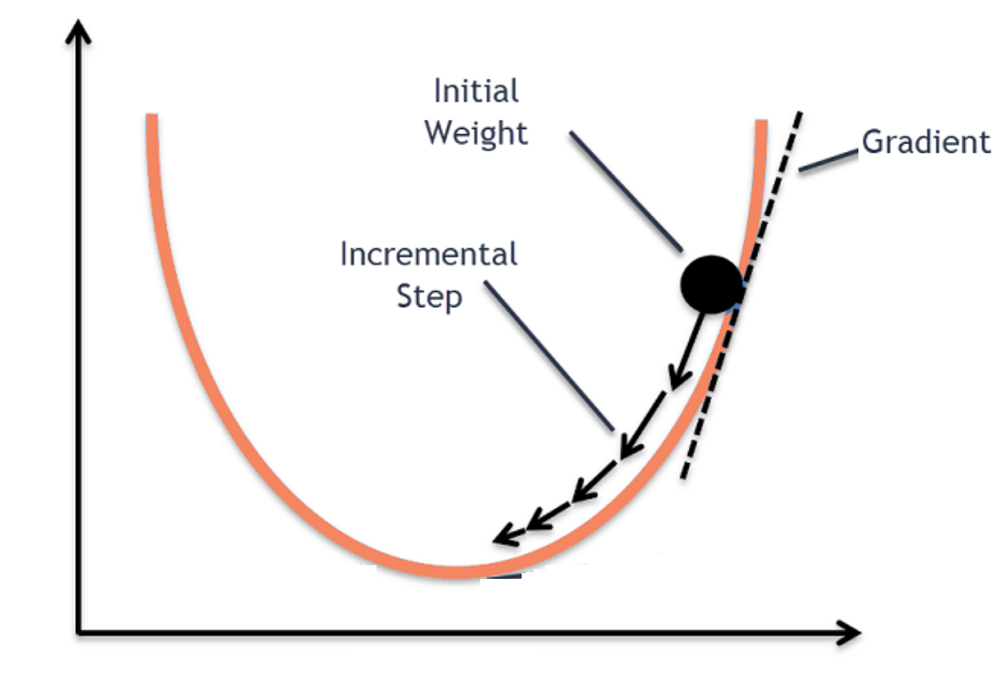
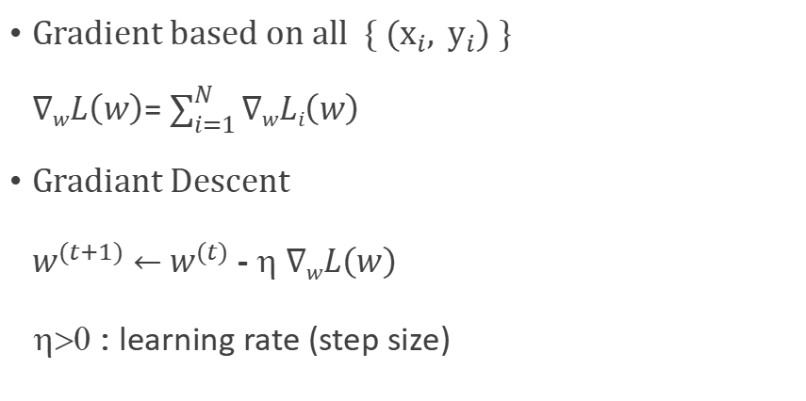
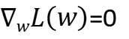
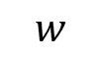
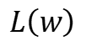
Minimizing Loss by Gradient Descent
Gradient based on all ${ \text{\{ }(\text{x}}_{i},{ \text{y}}_{i}) \}$
$∇wL\left(w\right)$= $\sum_{i=1}^{N}{∇wLi\left(w\right)}$
$Gradiant Descent$
${ w}^{(t+1)}$ $←$ $w^{(t)}$ - η $∇wL\left(w\right)$
η>0 : learning rate (step size)
$$L\left(w\right)$$
Positive
Negative
Gradient
$∇wL\left(w\right)$=0
$$w$$
Notes:
https://towardsdatascience.com/batch-mini-batch-stochastic-gradient-descent-7a62ecba642a
min_{w, delta x} L(w | {x, y}) , min_{w} sum_i L(w | x_i, y_i}) [L(w | x_i, y_i}) >= 0]

Slide 14
Outline
Multilayer Perceptron
Training and Optimization
Convolution Neural Networks
Classic CNN Model Architectures
Notes:
Looking for a Function

Slide 15
Data Types in ML
Data Type | Mathematics | Sequence of Data
0-D Number | x (real, natural, categorical) | x^{t}
1-D Array | vector x(i) | x^{t}(i)
2-D Array | matrix x(i,j) | x^{t}(i,j)
n-D Array | tensor x(i₁,i₂,…,i_{n}) | x^{t}(i₁,i₂,…,i_{n})

Slide 16
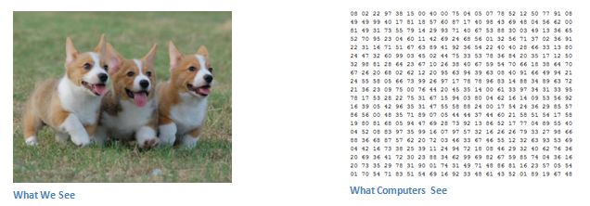
Image Representation

Slide 17
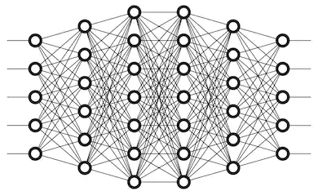

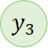
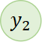
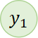
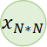
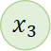
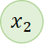
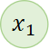
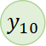
Motivations for CNN: Computational Reasons
$$x_{1}$$
$$y_{1}$$
Dog
Cat
…
…
Monkey
$$x_{2}$$
$$y_{2}$$
$$x_{3}$$
$$y_{3}$$
…
…
Image Size: N*N
$$x_{N∗N}$$
$$y_{10}$$
W1
Wfc
Input
W2
W4
Output: Class Scores
Layer 1
W3
layer 4
Layer 2
layer 3
Y=F(W)
Notes:
MLP for 10 Classes

Slide 18

Motivations for CNN: Computational Reasons
Too many parameters, Eg: 1K*1K = 1m → Overfitting
Lacking local descriptors
Lacking flexibility / invariance to shift and scaling
Solution: Decompose a single full-image convolution into many local-window convolutions → CNN
Notes:
全连接中一个神经元需要和所有的神经单元相连
对于一张图片大图片来讲的话是非常困难的
通过考虑图像的局部特征可以压缩信息

Slide 19

Motivations for CNN
Object pattern can vary in size, orientation in pose -- A DNN does not have to see the whole image to discover pattern
Object consists of parts -- A conv kernel can focus on a certain pattern (image part)
Connections for smaller region with fewer parameters
+
“ear” detector
Notes:
观察一个猫耳朵就可以判断出这是一只猫，因此只要判别出整张图片很小的区域即可

Slide 20
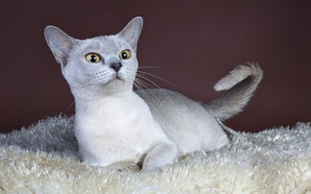
Translation Invariance and Weight Sharing
Similar patterns appear at different locations
“upper-right ear” detector
+
The two do the same thing mostly, hence can be shared
Parameter Sharing
+
“middle-right ear” detector
Notes:
不同图片的猫耳朵出现在不同的位置，不需要训练两套参数来识别

Slide 21
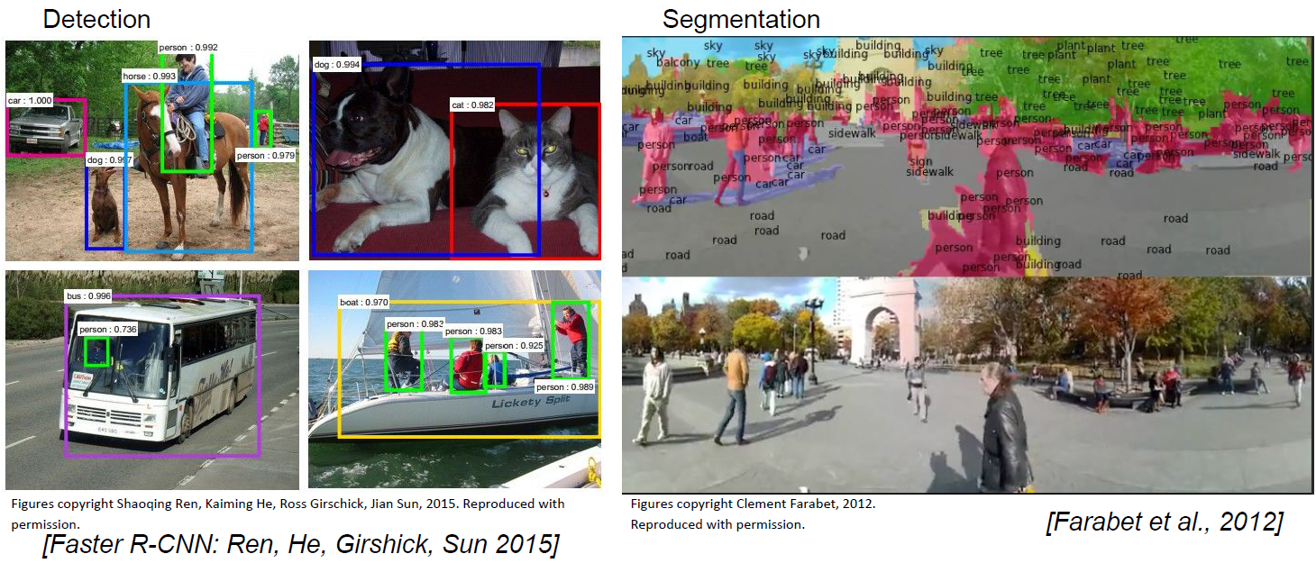
CNNs for Object Detection and Classification
Farabet et al. Learning Hierarchical Features for Scene Labeling. 2012.

Slide 22
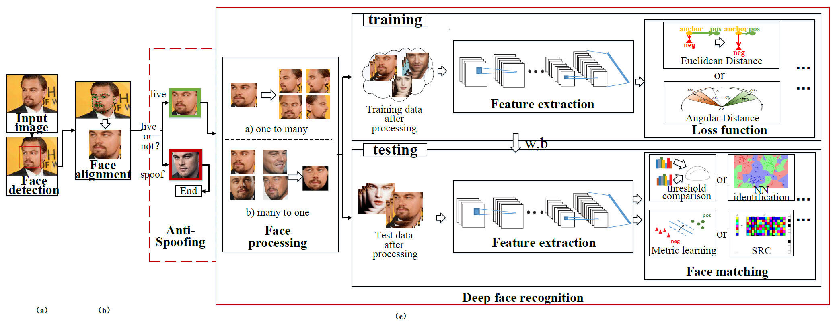
Face Recognition
Notes:
CNNs are used at every stage of this process
This is an illustration of Deep Learning based FR system along with face detector and alignment. In this system, CNNs are used throughout the system. First, a CNN-based face detector is used to localize faces. Second, the faces are aligned to normalized canonical coordinates based on CNN landmark features. Third, the FR module is implemented. The FR module includes several stages: First, face anti-spoofing identifies whether the face is live or a fake. Face preprocessing is performed to normalize before training and testing. CNNs are used extensively to train face feature extraction for the purpose of maximizing discriminative losses. Face matchers are used to do feature classification, that is, calculating similarity between a pair of faces.

Slide 23
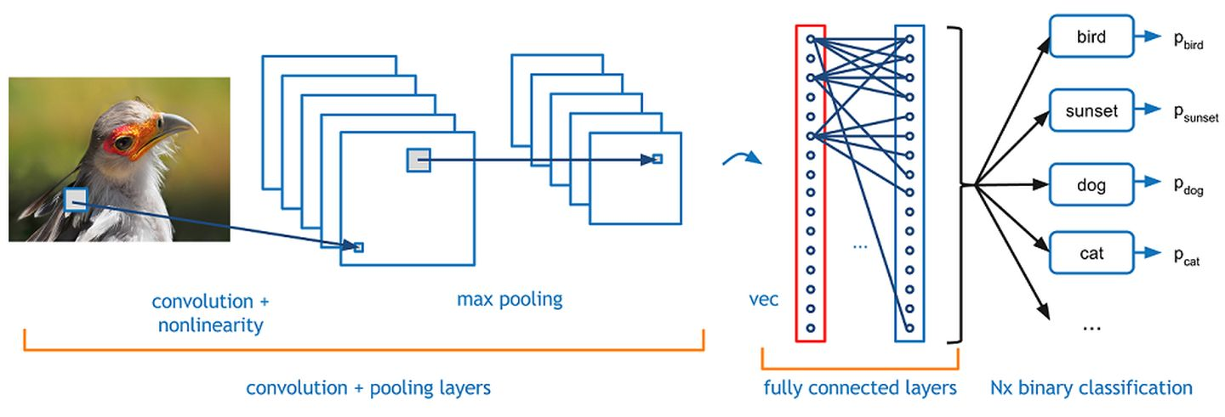
Overview of CNN for Classification

Slide 24

CNN Feature Extraction for Classification
Objects and parts can be much smaller than the whole image
They can appear at different locations (sliding kernels)
Convolution
Max pooling
Subsampling the pixels will not change object appearances
Convolution
Max pooling
Flatten
Notes:
介绍一下卷积的操作过程，引出卷积操作和池化操作

Slide 25
CNN Feature Extraction for Classification
Convolution
Classify into Cat, Dog …
Max pooling
Can repeat for many layers
Fully Connected network
Convolution
Max pooling
Flatten
Notes:
介绍一下卷积的操作过程，引出卷积操作和池化操作

Slide 26

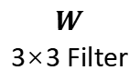
CNN-Convolution Operations
1
0
1
0
1
0
Input Image NxN
Stride =1
1
0
1
$$W$$
3×3 Filter
For W at the first location:
1×1+1×0+1×1+0×0+1×1+1×0+0×1+0×0+1×1 = 4
Notes:
介绍一下卷积的操作过程，引出卷积操作和池化操作

Slide 27
A Closer Look
7
7x7 input (spatially)
assume 3x3 filter
applied with stride=1
7
Notes:
输出特征图计算公式

Slide 28
A Closer Look
7
7x7 input (spatially)
assume 3x3 filter
applied with stride=1
7
Notes:
输出特征图计算公式

Slide 29
A Closer Look
7
7x7 input (spatially)
assume 3x3 filter
applied with stride=1
7
Notes:
输出特征图计算公式

Slide 30
A Closer Look: Stride=1
7
7x7 input (spatially)
assume 3x3 filter
applied with stride=1
7
Notes:
输出特征图计算公式

Slide 31
A Closer Look: Stride=1
7
7x7 input (spatially)
assume 3x3 filter
applied with stride=1
7
5×5 output
Notes:
输出特征图计算公式

Slide 32
A Closer Look
7
7x7 input (spatially)
assume 3x3 filter
applied with stride=2
7
Notes:
输出特征图计算公式

Slide 33
A Closer Look
7
7x7 input (spatially)
assume 3x3 filter
applied with stride=2
7
Notes:
输出特征图计算公式

Slide 34
A Closer Look: Stride=2
7
7x7 input (spatially)
assume 3x3 filter
applied with stride=2
7
3×3 output
Notes:
输出特征图计算公式

Slide 35
A Closer Look
7
7x7 input (spatially)
assume 3x3 filter
applied with stride=3?
7
Notes:
输出特征图计算公式

Slide 36
Stride and Output Size
A closer look at spatial dimensions:
N
Image N = 7, Kernel F = 3
stride 1 => (7 - 3)/1 + 1 = 5
stride 2 => (7 - 3)/2 + 1 = 3
stride 3 => (7 - 3)/3 + 1 = 2.33
F
F
N
Requirement on output size to integer:
(N - F) / stride + 1 = Integer
Notes:
输出特征图计算公式

Slide 37
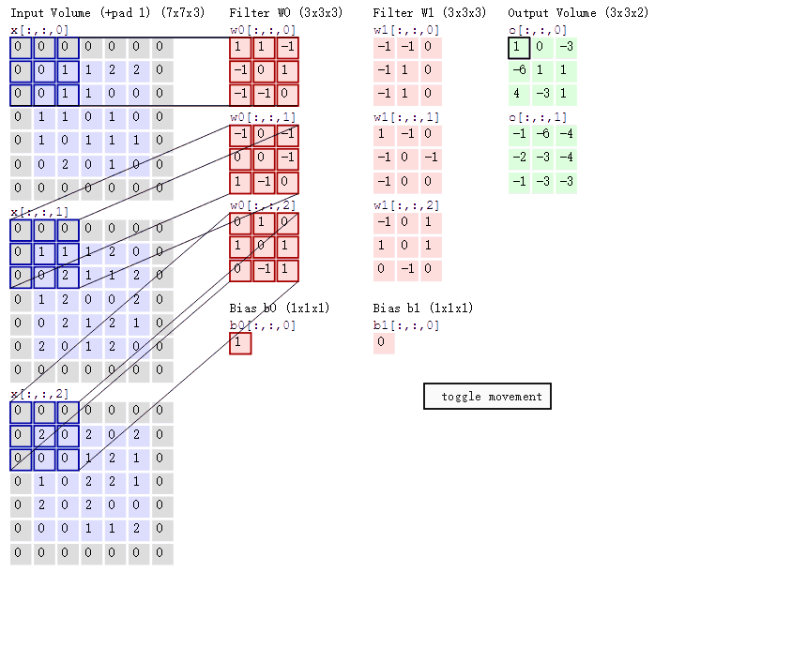
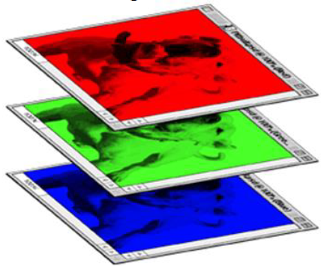
CNN for RGB Image（3-Channel) with 2 Kernels
RGB image
Notes:
RGB三通道的计算方法: https://www.zybuluo.com/hanbingtao/note/485480

Slide 38


3D Convolution for RGB Image
(5*5*3 = 75-D
dot product + bias)

Slide 39


What if we use three (3) 5x5 filters?
Output Three Maps

Slide 40
CNN for Classification
Convolution
Classify into Cat, Dog …
Max pooling
Can repeat for many layers
Fully Connected network
Convolution
Max pooling
Flatten
Notes:
介绍一下卷积的操作过程，引出卷积操作和池化操作

Slide 41
Pooling Purpose
Makes the representations smaller and more manageable
Eg. 2x2 → 1
Scale invariance

Slide 42


Scale Invariant
Subsampling the pixels (scaling down) will not change object
Subsampling
Subsampling pixels to make the image smaller
→ Use fewer parameters for the network to process the image
Notes:
对像素下采样不会改变图片本身的内容

Slide 43
Max Pooling
1 | 1 | 2 | 4
5 | 6 | 7 | 8
3 | 2 | 1 | 0
1 | 2 | 3 | 4
max pool with 2x2 filters
and stride 2
6 | 8
3 | 4
Notes:
最大池化的过程

Slide 44
Average Pooling
1 | 1 | 2 | 4
5 | 6 | 7 | 8
3 | 2 | 1 | 0
1 | 2 | 3 | 4
average pool with 2x2 filters
and stride 2
3.25 | 5.25
2 | 2
Notes:
平均池化的过程

Slide 45

Pooling for Multi-Channels
select max value across channels
Notes:
有padding输出特征图计算公式
使表示更小，更易于管理；对每个激活图进行独立操作：

Slide 46

Output of Pooling
Smaller than the original image.
The number of the channels is the number of filters
Convolution
Max pooling
Feature Map(s)
Convolution
Max pooling
Feature Map(s)
Notes:
Both outputs of activation and pooling are called feature maps

Slide 47
Typical Convolution Layers (Operations)
Building Blocks:
Convolutions with kernels
Nonlinear activations
Maximum/Average pooling
Dropout
Batch Normalization
Notes:
前面已经介绍过了激活函数、卷积核和池化，一般的卷积层还包含Dropout和Batch Normalization。

Slide 48

Dropout: A Regularizer to Reduce Overfitting
After activation, randomly shut down some during traininig
Notes:
By dropping a unit out, we mean temporarily removing it from the network, along with all its incoming and outgoing connections.
Dropout has the effect of making the training process noisy, forcing nodes within a layer to probabilistically take on more or less responsibility for the inputs.
This conceptualization suggests that perhaps dropout breaks-up situations where network layers co-adapt to correct mistakes from prior layers, in turn making the model more robust.
Change neural units in a way that they fix up the mistakes of the other units. This may lead to complex co-adaptations. This in turn leads to overfitting because these co-adaptations do not generalize to unseen data. […]
Dropout simulates a sparse activation from a given layer, which interestingly, in turn, encourages the network to actually learn a sparse representation as a side-effect. As such, it may be used as an alternative to activity regularization for encouraging sparse representations in autoencoder models.
So a side-effect of doing dropout, the activations of the hidden units become sparse, even when no sparsity inducing regularizers are present.
Please note that Because the outputs of a layer under dropout are randomly subsampled, it has the effect of reducing the capacity or thinning the network during training. As such, a wider network, e.g. more nodes, may be required when using dropout.

Slide 49

Batch Normalization

Slide 50
CNN Feature Extraction for Classification
Convolution
Classify into Cat, Dog …
Max pooling
Fully Connected network
Convolution
Max pooling
Flatten
Notes:
介绍一下卷积的操作过程，引出卷积操作和池化操作

Slide 51
Flatten into Feature Vector
Flatten
MLP：
Full Connected network

Slide 52


One Layer Perceptron for 10 Classes
The result of taking a dot product
between a row of W and the input (3072-dimensional dot product)
--- correlation between input and a matched filter (kernel)
32x32x3 image ->
stretch to 3072 x 1 vector
10 convolution kernels (templates)
. . . . . . . . .

Slide 53

Notes:
重新总结一下卷积的操作完整流程 10 Kernels, Channel （示意图）

Slide 54

Closer Look: First Layer Filters

Slide 55

Closer Look: Intermediate Features

Slide 56

Last Layer: Nearest Neighbors

Slide 57
CNN Basic Structure: A Summary
The CNN is a cascade of nonlinear filtering (Kernel) transformation for the underlying data patches (Receptive Field -- RF)
Convolution filter: inner product (Kernel·RF) followed by a nonlinear activation function at every location of input
CNN = (Convolutional filter + Pooling)^{L} → Outputs feature maps
Downstream tasks: based on feature vectors (flattened maps)

Slide 58
Outline
Multilayer Perceptron
Training and Optimization
Convolution Neural Networks
Classic CNN Model Architectures
Notes:
Looking for a Function

Slide 59
Overview: Classic Network Structures
NIN
Inception
(GoogLeNet)
Improvement in CNN Structure
LeNet
AlexNet
Further Improvement in Depth
Improvement in Depth
VGGNet
ResNet
Inception
GoogleNet
VGG
LeNet-5
AlexNet
NIN
ResNet
1989
2012
2013
2014
2015
Notes:
网络模型的一个发展过程

Slide 60

LeNet-5
CNN Structure:
Input
Conv1
Max Pool1
Conv2
Max Pool2
FC1
FC2
Output
LeCun, Yann, et al. “Handwritten digit recognition with a backpropagation neural network." 1989.
Notes:
LeNet 是整个卷积神经网络的开山之作，是卷积神经网络的现代雏形，1998年由LeCun提出。最初设计的目的是识别手写字母，被广泛应用在美国支票手写识别系统当中。1989年提出，对后面所有CNN奠定了很重要的基础.
卷积神经网络能够很好的利用图像的结构信息。卷积层的参数较少 – 局部连接和共享权重
卷积和下采样相结合， LeNet用于手写体字符识别非常高效
Input: 32*32 image
C1 layer: channel 6, filter 5*5, feature map 32-5+1=28, 6* 28*28
S2 layer：filter 2*2, feature map 6 *14*14
C3 layer：channel 16, filter 5*5, feature map 14-5+1=10, 16*10*10
S4 layer：filter 2*2, feature map 16*5*5。
C5 layer：channel 120, filter 5*5, feature map 5-5+1, 120*1*1
FC6 layer: 84
Output : 10
缺点：
网络层数很浅
没有激活层

Slide 61

AlexNet
Krizhevsky, Alex et al. “Imagenet classification with deep convolutional neural networks.” 2012.
Notes:
AlexNet 可以说是具有历史意义的一个网络结构，在此之前，深度学习已经沉寂了很长时间，自 2012 年 AlexNet 诞生之后，后面的 ImageNet 冠军都是用卷积神经网络（CNN）来做的，并且层次越来越深，使得CNN成为在图像识别分类的核心算法模型，带来了深度学习的大爆发。
AlexNet是把CNN做深的一个尝试，由5个卷积层和3个全连接层构成，其中采用了RELU激励函数以及局部响应归一化（LRN）处理，它赢得了2012年ImageNet 冠军，推动了卷积神经网络甚至是深度学习的发展。
第⼀，与相对较小的 LeNet 相⽐， AlexNet 包含 8 层变换，其中有 5 层卷积和 2 层全连接隐藏层，以及 1 个全连接输出层。AlexNet 第⼀层中的卷积窗⼝形状是 11×11。因为 ImageNet 中绝⼤多数图像的⾼和宽均⽐ MNIST 图像 的⾼和宽⼤ 10 倍以上， ImageNet 图像的物体占⽤更多的像素，所以需要更⼤的卷积窗⼝来捕获物体。第⼆层中的卷积窗⼝形状减⼩到 5×5 ，之后全采⽤ 3×3。此外，第⼀、第⼆和第五个卷积层之后都使用了窗⼝形状为 3×3 、步幅为 2 的最⼤池化层。⽽且， AlexNet 使用的卷积通道数也⼤于 LeNet 中的卷积通道数数⼗倍。
第⼆，AlexNet 将 sigmoid 激活函数改成了更加简单的 ReLU 激活函数。⼀⽅⾯， ReLU 激活函数的计算更简单，例如它并没有 sigmoid 激活函数中的求幂运算。另⼀⽅⾯，ReLU 激活函数在不同的参数初始化⽅法下使模型更容易训练。这是由于当 sigmoid 激活函数输出极接近 0 或 1 时，这些区域的梯度几乎为 0，从⽽造成反向传播⽆法继续更新部分模型参数；⽽ ReLU 激活函数在正区间的梯度恒为 1。因此，若模型参数初始化不当， sigmoid 函数可能在正区间得到几乎为 0 的梯度，从⽽令模型⽆法得到有效训练。

Slide 62
Features of AlexNet
Trained with big data: Millions of ImageNet data
Use ReLU nonlinear activation function
Reducing overfitting by dropout, data augmentation
Two GPUs for parallel computation

Slide 63


VGG
VGG is even deeper network than AlexNet
8 layer (AlexNet) -> 16-19 (VGG)
Use consecutive 3x3 kernels to replace
bigger (5x5, 11x11) kernels in AlexNet
Deeper means more nonlinear and can
perform more complicated transforms,
and with lower computation costs
2014 ILSVRC top 5 -> 11.7%-> 7.3%
Simonyan, Karen et al. "Very deep convolutional networks for large-scale image recognition." 2014.
Notes:
VGG is deeper than AlexNet and uses smaller conv kernels
VGG16相比AlexNet的一个改进是采用连续的几个3x3的卷积核代替AlexNet中的较大卷积核（11x11，7x7，5x5）。对于给定的感受野（与输出有关的输入图片的局部大小），采用堆积的小卷积核是优于采用大的卷积核，因为多层非线性层可以增加网络深度来保证学习更复杂的模式，而且代价还比较小（参数更少）。
Eg.，在VGG中，使用了3个3x3卷积核来代替7x7卷积核，使用了2个3x3卷积核来代替5*5卷积核，这样做的主要目的是在保证具有相同感知野的条件下，提升了网络的深度，在一定程度上提升了神经网络的效果。
从感受野角度来说，两个3∗3的卷积核叠加，就等于一个5∗5的卷积核的结果。可是从参数量上，前者明显会小于后者。而且从分层角度上看，因为之间会通过非线性激活函数的转换，所以3∗33∗3的卷积核叠加还能得到更非线性的特征提取结果

Slide 64

Large numbers of parameters are used in FCs
Notes:
大部分参数在全连接神经网络上

Slide 65

NIN Structure
3 MLPconv Layers + Global Average Pooling Layer
Notes:
该篇论文是首次提出1*1卷积，具有划时代的意义，之后的Googlenet借鉴了1*1卷积，还专门致谢过这篇论文。
CNN网络中不使用FC层（全连接层） 文中提出使用Global Average Pooling取代最后的全连接层，因为全连接层参数多且易过拟合。做法即移除全连接层，在最后一层（文中使用mlpconv）层，后面加一层Average Pooling层。
上图看出，该网络结构有三个MLP卷积层组成，每个MLP卷积层分别是一个普通卷积，加两个1*1卷积。以1000分类为例，最后一个1*1卷积输出的featuremap大小为6*6*1000。之后每个featuremap采用全局均值池化，输出1000个分类。由于没有全连接的大量参数，使用全局均值池化不需要参数，极大的降低了参数量。

Slide 66
Network in Network (NIN)
MLPconv: In NIN, the linear convolution operation (dot product) is replaced with a general nonlinear “micro network”
MLPconv layer vs CNN: Mapping the input local patch to the output feature vector with an MLP vs linear convolution
Lin, Chen and Yan. "Network in network." 2013.

Slide 67


MLPconv to Replace Linear Conv
… n-layer MLP
Notes:
The linear convolution layer includes a linear filter while the mlpconv layer includes a micro network (MLP). (i,j) is the pixel index in the feature map, xij stands for the input patch centered at location (i,j), and k index the channels.
From cross channel (cross feature map) pooling point of view, Equ 2 is equivalent to cascaded cross channel parametric pooling on a normal convolution layer. Each pooling layer performs weighted linear recombination on the input feature maps, which then go through a rectifier linear unit. The cross channel pooled feature maps are cross channel pooled again and again in the next layers. This cascaded cross channel parametric pooling structure allows complex and learnable interactions of cross channel information.
The cross channel parametric pooling layer is also equivalent to a convolution layer with 1x1 convolution kernel
（i,j）为点的位置，k为通道下标。 wk,n 表示第 n 层卷积卷积参数。通过在网络中构建微型网络，Mlpconv对 conv特征进行了组合，提高了单个卷积的 有效性。通过 1×1卷积快速实现。
在普通的卷积层之后加上1x1的卷积核，配合激活函数，就可以实现MLPconv layer的基本结构。
论文中还解释了为何micro network不使用maxout network: maxout network通过对affine feature maps进行最大池化达到减少feature maps数量的目的（affine feature maps是 linear convolution 不带activation function直接计算得到的结果）。最大池化线性函数的结果能够得到一个可以逼近任何凸函数的分段线性逼近器，所以与进行线性划分的传统卷积层相比，maxout network效果更好，因为它能够对位于凸集（Convex set）内的concepts进行正确划分。但是，maxout network默认在输入空间中latent concepts的samples分布在一个凸集内，这一先验知识却不一定成立。考虑到distributions of the latent concepts的复杂性，我们需要的是一个更加通用的函数逼近器（more general function approximator），比如MLP

Slide 68


Inception v1 – Multi-scale Kernels
Notes:
This lead to the “naive” version of inception module. It performs convolution on an input, with 3 different sizes of filters (1x1, 3x3, 5x5). Additionally, max pooling is also
performed. The outputs are concatenated and sent to the next inception module.
To make it computationally less costly, the authors limit the number of input channels by adding an extra 1x1 convolution before the 3x3 and 5x5 convolutions. Though adding an extra operation may seem counterintuitive, 1x1 convolutions are far cheaper than 5x5 convolutions, and the reduced number of input channels also help. Do note that however, the 1x1 convolution is introduced after the max pooling layer, rather than before.

Slide 69

Inception V1 → GoogLeNet（2014）
Convolution
Pooling
Softmax
Other
Szegedy, Christian, et al. "Going deeper with convolutions." 2015.
Notes:
Inception(Szegedy, Liu et al. 2015)在NIN基础上，增加多尺度卷积通道，结合1x1卷积降维，以及卷积核分解等精巧设计，降低了网络复杂度，同时提升了卷积网络的特征表达能力，

Slide 70



Inception V2&3
Notes:
Inception v2 and Inception v3 were presented in the same paper. The authors proposed a number of upgrades which increased the accuracy and reduced the computational complexity. Inception v2 explores the following:
The Premise:
Reduce representational bottleneck. The intuition was that, neural networks perform better when convolutions didn’t alter the dimensions of the input drastically. Reducing the dimensions too much may cause loss of information, known as a “representational bottleneck”
Using smart factorization methods, convolutions can be made more efficient in terms of computational complexity.

Slide 71
Inception V2&3-A：Factorize 5 X 5 → 2*3 X 3
Notes:
The Solution:
Factorize 5x5 convolution to two 3x3 convolution operations to improve computational speed. Although this may seem counterintuitive, a 5x5 convolution is 2.78 times more expensive than a 3x3 convolution. So stacking two 3x3 convolutions infact leads to a boost in performance. This is illustrated in the below image.

Slide 72
Inception V2&3-B：Factorize N X N → 1 X N and N X 1
Notes:
Moreover, they factorize convolutions of filter size nxn to a combination of 1xn and nx1 convolutions. For example, a 3x3 convolution is equivalent to first performing a 1x3 convolution, and then performing a 3x1 convolution on its output. They found this method to be 33% more cheaper than the single 3x3 convolution. This is illustrated in the below image.

Slide 73
Inception V2&3-C：Filter banks made wider
Notes:
The filter banks in the module were expanded (made wider instead of deeper) to remove the representational bottleneck. If the module was made deeper instead, there would be excessive reduction in dimensions, and hence loss of information.

Slide 74

Inception v4
Notes:
Inception v4
Inception v4 and Inception-ResNet were introduced in the same paper.
Inception v4 introduced specialized “Reduction Blocks” which are used to change the width and height of the grid. The earlier versions didn’t explicitly have reduction blocks, but the functionality was implemented.

Slide 75

Performance Degrades When Going Deeper
Notes:
However, increasing network depth does not work by simply stacking layers together. Deep networks are hard to train because of the notorious vanishing gradient problem — as the gradient is back-propagated to earlier layers, repeated multiplication may make the gradient infinitively small. As a result, as the network goes deeper, its performance gets saturated or even starts degrading rapidly.
When deeper networks are able to start converging, adegradation problem has been exposed: with the network
depth increasing, accuracy gets saturated (which might be unsurprising) and then degrades rapidly. Unexpectedly,
such degradation is not caused by overfitting, and adding more layers to a suitably deep model leads to higher training error, as reported.
Before ResNet, there had been several ways to deal the vanishing gradient issue, for instance, [4] adds an auxiliary loss in a middle layer as extra supervision, but none seemed to really tackle the problem once and for all.

Slide 76
ResNet：Residual Block
H(x)
relu
F(x)+x
conv
conv
relu
relu
F(x)
X Identity
conv
conv
x
x
Traditional CNN Blocks
Residual block
He, Kaiming, et al. "Deep residual learning for image recognition." 2016.
Notes:
After the celebrated victory of AlexNet [1] at the LSVRC2012 classification contest, deep Residual Network [2] was arguably the most groundbreaking work in the computer vision/deep learning community in the last few years. ResNet makes it possible to train up to hundreds or even thousands of layers and still achieves compelling performance.
According to the universal approximation theorem, given enough capacity, we know that a feedforward network with a single layer is sufficient to represent any function. However, the layer might be massive and the network is prone to overfitting the data. Therefore, there is a common trend in the research community that our network architecture needs to go deeper.
Since AlexNet, the state-of-the-art CNN architecture is going deeper and deeper. While AlexNet had only 5 convolutional layers, the VGG network [3] and GoogleNet (also codenamed Inception_v1) [4] had 19 and 22 layers respectively.
The core idea of ResNet is introducing a so-called “identity shortcut connection” that skips one or more layers, as shown in this figure. The authors of ResNet argue that stacking layers shouldn’t degrade the network performance, because we could simply stack identity mappings (layer that doesn’t do anything) upon the current network, and the resulting architecture would perform the same. This indicates that the deeper model should not produce a training error higher than its shallower counterparts. They hypothesize that letting the stacked layers fit a residual mapping is easier than letting them directly fit the desired underlaying mapping. And the residual block above explicitly allows it to do precisely that.
The dimensions of x and F must be equal in Eqn.(1). If this is not the case (e.g., when changing the input/output
channels), we can perform a linear projection Ws by the shortcut connections to match the dimensions

Slide 77

ResNet: Results on ILSVRC’15
ILSVRC = ImageNet Large Scale Visual Recognition Competition

Slide 78

Inception-ResNet v1 and v2
Notes:
Inspired by the performance of the ResNet, a hybrid inception module was proposed. There are two sub-versions of Inception ResNet, namely v1 and v2.
Inception-ResNet v1 has a computational cost that is similar to that of Inception v3.
Inception-ResNet v2 has a computational cost that is similar to that of Inception v4.
They have different stems, as illustrated in the Inception v4 section.
Both sub-versions have the same structure for the modules A, B, C and the reduction blocks. Only difference is the hyper-parameter settings. In this section, we’ll only focus on the structure. Refer to the paper for the exact hyper-parameter settings (The images are of Inception-Resnet v1).

Slide 79
Q & A

Slide 80
下 课

